Slide 1
Instructions on making the poster
Slide 2 is a poster template – all the fonts, the size of the poster etc are pre-set.
  Do not change the size of the poster (42 x 31)
  You may have colored images and text
  You may NOT have a colored background
The template is a guideline. You can type right over the text I have placed there. Adapt it as necessary to accommodate your data. Each section may be larger or smaller than I have indicated based on your project.
What often works well is taking your summer presentation and using the figures from those slides to make your poster. Your mentor may have additional recommendations.
Use your own images, figures, spectra, graphs etc rather than clip art
  You may add Muhlenberg College graphics in the title area
  Don’t forget about your summer photoshoot! Those photos are great for your poster as well!

Slide 2

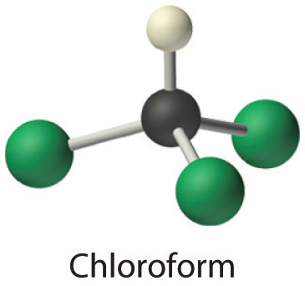
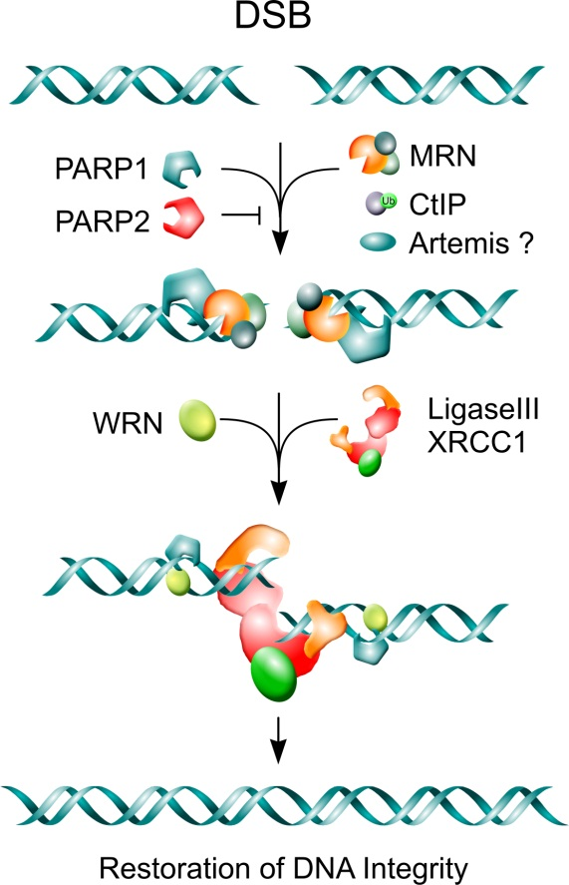
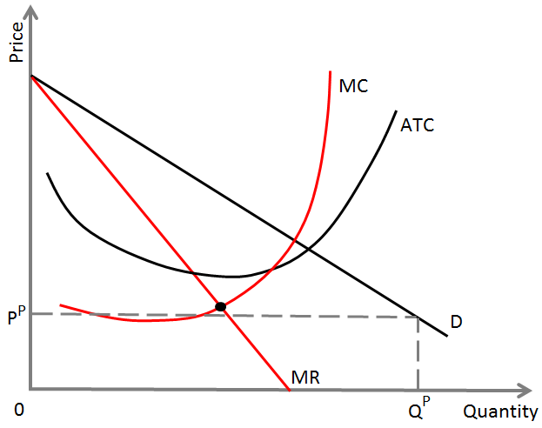
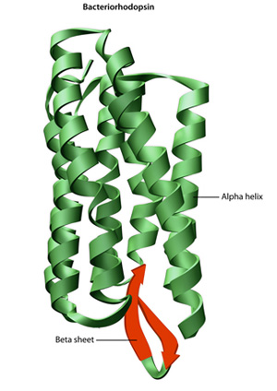
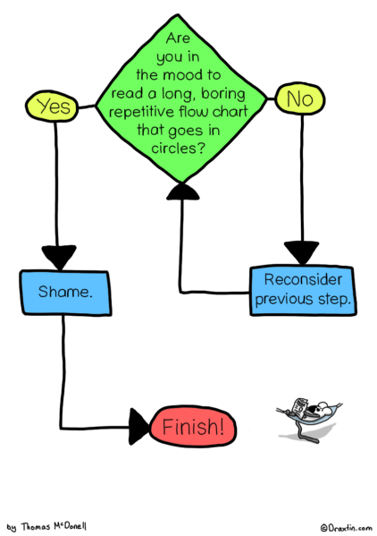
The Title of My Poster
Joe Student, John Collaborator, and Dr. Jill Mentor
Department of Science, Muhlenberg College
Funded By: Generous Funding Agency
Fun picture of my research
(Pictures of Joe Student presenter)
Introduction
Results
Conclusions
In the introduction, you should briefly orient the reader to the PROBLEM(S) your research tried to solve or the QUESTION your work tried to answer.
What is the theoretical, historical or interpretive context for this research?
Answer the “So what?” question. Why is this important?
The important section! What did you find? Indicate how each piece of data contributes to solving the problems or answering the question you outlined in your introduction.
How do your results inform your overall problem or question? What have you learned that distinguishes your work from the existing scholarly community in your discipline. Do you have a model or mechanism?
Step 1
Step 2
Step 3
Step 4
Step 5
Experiment #1 shows X
Display your data in tables, graphs, figures or pictures. Explain what the data mean. Provide legends. Use arrows to point out important features in the data.
This is important!
Diagrams or schemes help contextualize your conclusions.
Return to the “so what?” question. Why is this work important?
Include a figure, diagram or other image that illustrates your most important point(s).
Are the numbers, axes etc in a font that is large enough to be visible?
Material and Methods
Experiment #2 to investigate X
You can certainly have more that two graphs/images/pictures/ spectra. Remember that the audience needs to be able to get your point quickly and easily – use text sparingly.
Here you would describe HOW you went about answering your problem/ question. This is best illustrated with pictures, diagrams etc that show the instrumentation or methodology you employed in your work.
References
Smith, Ann. (2012) J of Awesome, 100 (3) 211-215
Johnson, John (1976) Acta Importanta, 10 (1), 5.
The font can be smaller in this section
Experiment #3 demonstrates dependence of X on Y
It is typical to organize your results by experiment, and the experiments flow in the order that best tells the story of your research. This is just one way to organize the data. Talk with your research advisor on how to best represent your results.
You could also outline an experimental approach or strategy
Acknowledgments
Here is where you list the people who helped you
Notes:
Did you have a summer research photo shoot? Use the pictures from that on your poster.
This template option has “boundary boxes” around the sections. This is one way of organizing the poster – but the boxes are not required. See the slide that follows.

Slide 3

The Title of My Poster
Joe Student, John Collaborator, and Dr. Jill Mentor
Department of Science, Muhlenberg College
Funded By: Generous Funding Agency
Fun picture of my research
(Pictures of Joe Student presenter)
Introduction
Results
Conclusions
In the introduction, you should briefly orient the reader to the PROBLEM(S) your research tried to solve or the QUESTION your work tried to answer.
What is the theoretical, historical or interpretive context for this research?
Answer the “So what?” question. Why is this important?
The important section! What did you find? Indicate how each piece of data contributes to solving the problems or answering the question you outlined in your introduction.
How do your results inform your overall problem or question? What have you learned that distinguishes your work from the existing scholarly community in your discipline. Do you have a model or mechanism?
Step 1
Step 2
Step 3
Step 4
Step 5
Experiment #1 shows X
Display your data in tables, graphs, figures or pictures. Explain what the data mean. Provide legends. Use arrows to point out important features in the data.
This is important!
Diagrams or schemes help contextualize your conclusions.
Return to the “so what?” question. Why is this work important?
Include a figure, diagram or other image that illustrates your most important point(s).
Are the numbers, axes etc in a font that is large enough to be visible?
Material and Methods
Experiment #2 to investigate X
You can certainly have more that two graphs/images/pictures/ spectra. Remember that the audience needs to be able to get your point quickly and easily – use text sparingly.
Here you would describe HOW you went about answering your problem/ question. This is best illustrated with pictures, diagrams etc that show the instrumentation or methodology you employed in your work.
References
Smith, Ann. (2012) J of Awesome, 100 (3) 211-215
Johnson, John (1976) Acta Importanta, 10 (1), 5.
The font can be smaller in this section
Experiment #3 demonstrates dependence of X on Y
It is typical to organize your results by experiment, and the experiments flow in the order that best tells the story of your research. This is just one way to organize the data. Talk with your research advisor on how to best represent your results.
You could also outline an experimental approach or strategy
Acknowledgments
Here is where you list the people who helped you
Notes:
You don’t need to have the boundary boxes – but you should organize your sections as though there were an “invisible box” there.
Did you have a summer research photo shoot? Use the pictures from that on your poster.

Slide 4
Instructions on printing your poster
Save this file under a new file name with the format: Yourlastname_postersession_2017
Delete all instructions slides and save
  The file will now contain one slide, and it will be the slide of your poster
Now save the file again as a PDF. Under Save as > pdf
Submit the pptx and pdf files to the assignment link in Canvas by September 8, 2017
  Indicate in the assignment notes that this poster should be 42 x 31
  Your poster will be delivered to the CA on 9/16. Arrive between 10:30-10:45am to hang your poster.

Slide 5
Instructions on presenting your poster
Retrieve your poster and pin it up on an easel in the CA by 10:45am on Saturday morning, 9/22
Dress professionally
Greet visitors as they come to your poster, you could say – “Hi, I’m Jill, would you like to hear about my research?”
Give an interested visitor a guided “tour” of your poster – i.e. walk them through from intro to conclusions, pointing out the highlights.
Thank each person for visiting your poster

Slide 6











Muhlenberg images you may want to use in your poster

